Slide 1
Oxycodone and Illicit Drug Tweets
Patrick Morabito
8/13/15 Research Meeting

Slide 2
Search Methodology
Simplistic keyword search
Oxycodone keywords from brand names and various slang
Illicit Drug keyword from Chris/Henry

Slide 3
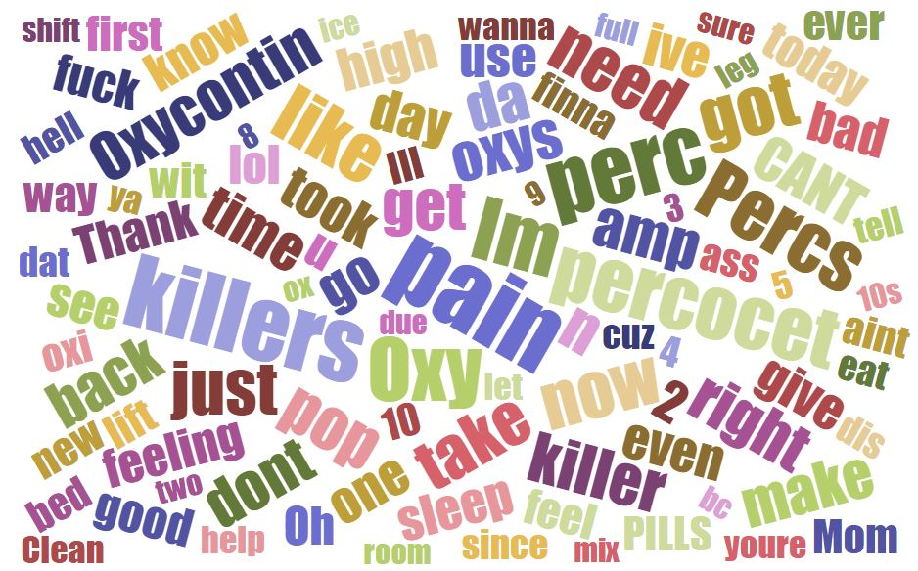
Quick Oxycodone Tweet Word Cloud

Slide 4
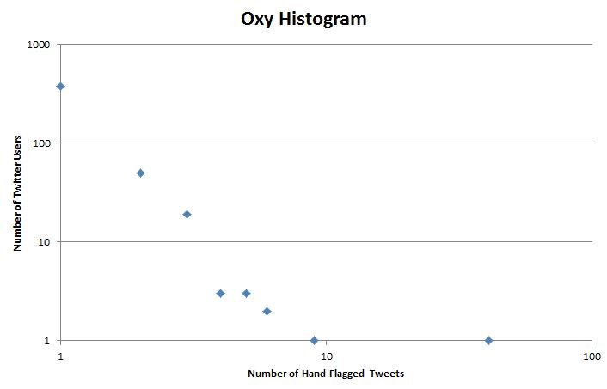
Oxycodone Tweets
Expanded volume of tweets sorted through
Up from 178 hand verified relevant tweets to 621
454 unique tweeters

Slide 5
Triangles
Reciprocal Triangle
Non-Reciprocal Triangle

Slide 6
Oxycodone Tweeter’s Social Graph
361 of 454 tweeters in social graph
120 have some form of interconnection
55 reciprocally connected pairs between 99 distinct users (89 in the graph file)
43 pairs with both users in the graph file form 1678 reciprocal triangles with 1599 additional non-oxy users
1 pair with both users in the graph file form zero reciprocal triangles
78 of the 1599 additional non-oxy users are in more than one reciprocal triangle
12 of the original oxycodone tweeters, but not from the 120 with interconnections, form connections with the 78 multi-reciprocal triangle users

Slide 7
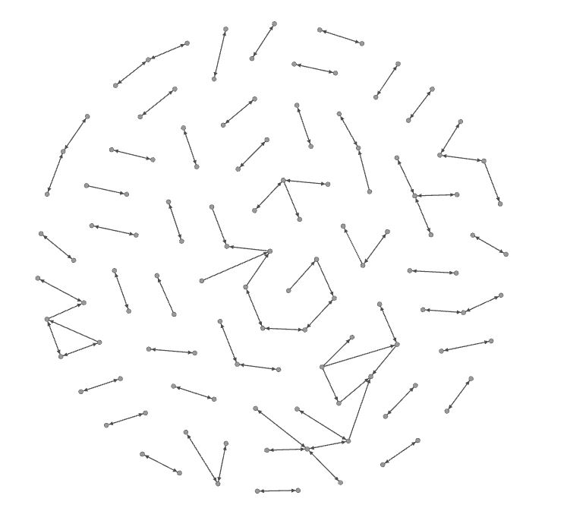
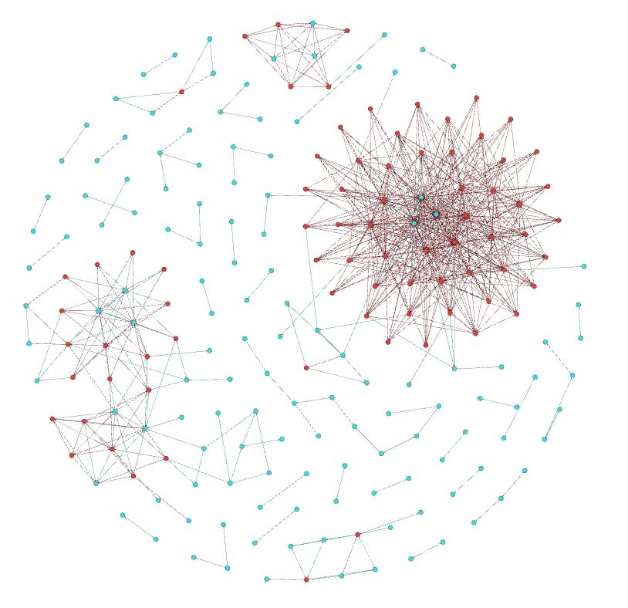
Oxy Connection Visualizations
132 Oxycodone Tweets (blue) and
78 multi-reciprocal triangle forming tweets (red)
120 Oxycodone Tweets

Slide 8
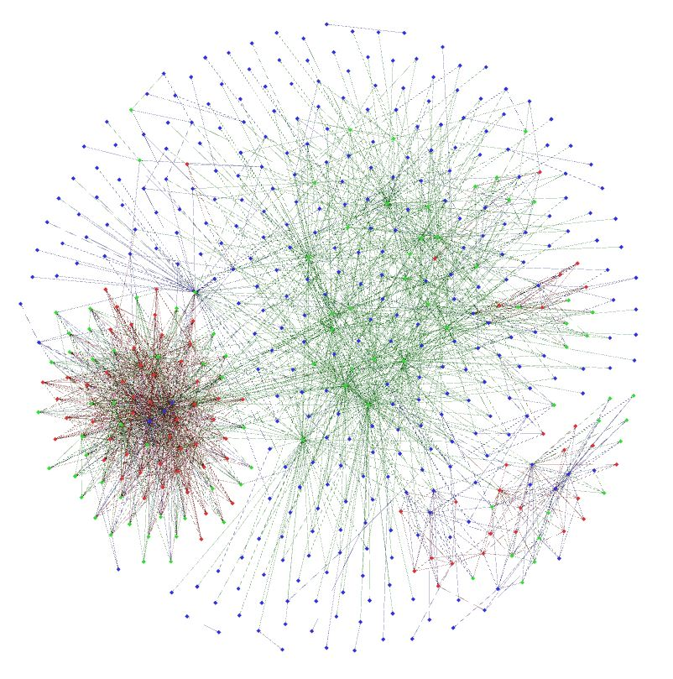
Non-Reciprocal Oxy Triangles
+93 new multi non-reciprocal forming triangle users (green)

Slide 9
Illicit Drug Tweets
Only smaller 1-year tweet file searched
20469 tweets found
Small hand-sampling showed much higher correctly flagged tweet percentage than oxycodone search
7094 unique tweeters

Slide 10
Illicit Drug Tweeter’s Social Graph
3919 of 7094 tweeters in social graph
5732 have some form of interconnection
2700 reciprocally connected pairs between 3927 distinct users (3337 in the graph file)
1659 pairs with both users in the graph file form 47,289 reciprocal triangles with 30,677 additional users
40 pairs with both users in the graph file form zero reciprocal triangles
8662 of the 30,677 additional users are in more than one reciprocal triangle
From the 47,289 reciprocal triangles, 2596 are composed of all three members from the original set of tweeters, totaling to 2157 unique users

Slide 11
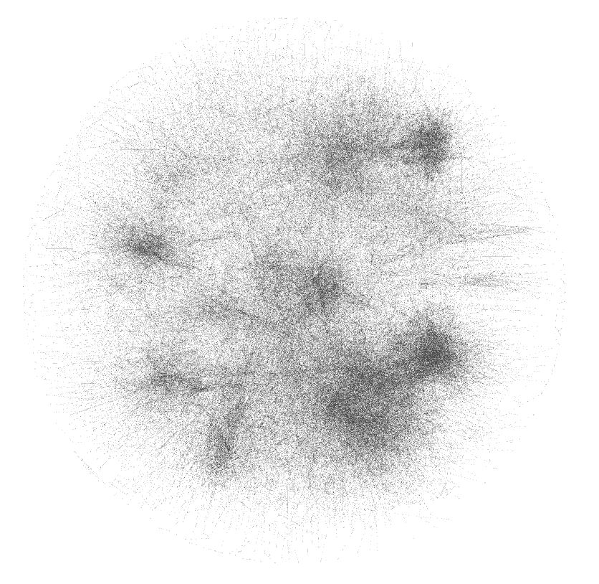
5732 Interconnected Illicit Drug Tweeters

Slide 12
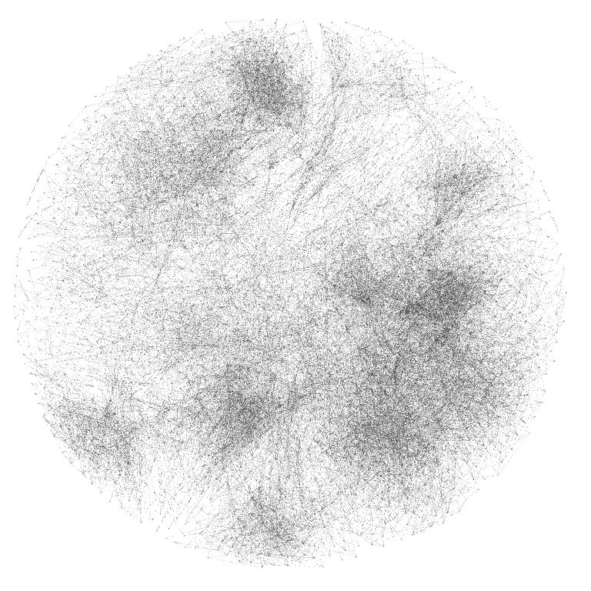
2157 Complete Reciprocal Triangle Forming Illicit Drug Tweeters

